Slide 1
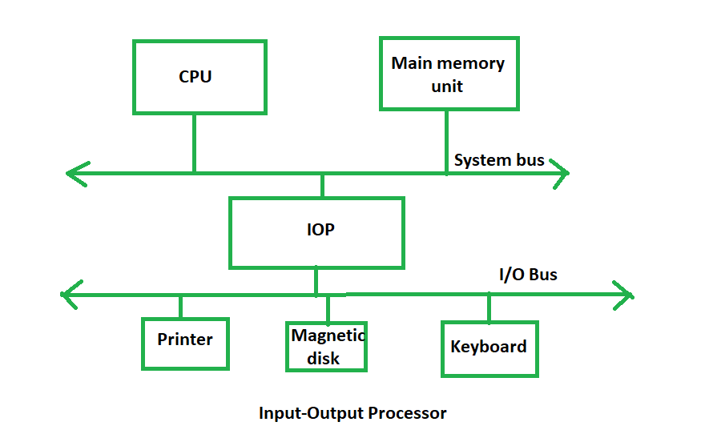
Example

Slide 2
Central Processing Unit 2 Lecture 22
Overview
Peripheral Devices
Input-Output Interface
Asynchronous Data Transfer
Modes of Transfer
Priority Interrupt
Direct Memory Access
Input-Output Processor
Serial Communication
CSE 211, Computer Organization and Architecture

Slide 4
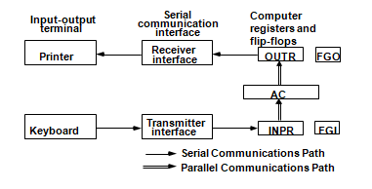

Slide 5
Input/Output Organization 5
Input Output Organization
I/O Subsystem
Efficient Mode Of Communication
between central system and outside environment
Programmed, Input Data, Process, Record, Display Results.
Slow Keyboard →Processor Idles Waiting For Slow Input.
time of waiting is more for information to arrive
E.G. Magnetic Tapes, Disks

Slide 6
Input/Output Organization 6
Peripheral Devices
Devices under direct control of computer are
→connected on-line.
Peripherals →I/O devices attached to the computer
There are three types of peripherals :
Input peripherals
Output peripherals
Input-output peripherals

Slide 7
Input/Output Organization 7
Peripheral Devices
Peripheral (or I/O Device)
Monitor →(Visual Output Device) : CRT, LCD
KeyBoard →(Input Device) : light pen, mouse, touch screen, joy stick, digitizer
Printer →(Hard Copy Device) : Daisy wheel, dot matrix and laser printer
Storage Device → Magnetic tape, magnetic disk, optical disk

Slide 8
Input/Output Organization 8
Peripheral Devices
Input Devices
Output Devices
Keyboard
Optical input devices
- Card Reader
- Paper Tape Reader
- Bar code reader
- Optical Mark Reader
Magnetic Input Devices
- Magnetic Stripe Reader (ATM)
Screen Input Devices
- Touch Screen
- Light Pen
- Mouse
Card Puncher, Paper Tape Puncher
CRT
Printer (Daisy Wheel, Dot Matrix, Laser)
Plotter

Slide 9
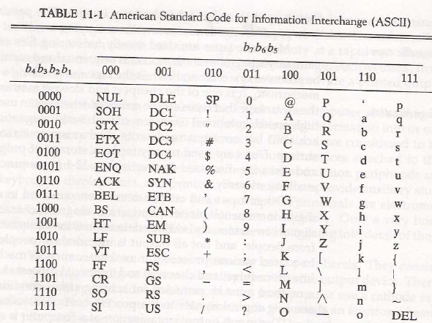

Slide 10
Input/Output Organization 10
Input Output Organization
ASCII (American Standard Code for Information Interchange)
I/O communications usually involves data transfer
Alphanumeric information from device and the computer.
Standard binary code for alphanumeric character is ASCII
ASCII Code :
It uses 7 bits to code 128 characters (94 printable and 34 non printing)
7 bit - 00 - 7F ( 0 - 127 )

Slide 11
Input/Output Organization 11
Input Output Organization
ASCII (American Standard Code for Information Interchange)
ASCII is 7 bits but,
→most computers manipulate 8 bit quantity as a
single unit called byte.
80 - FF ( 128 - 255 ) : Greek, Italic type font
Three types of control characters: Format effectors, Information separators and communication control

Slide 12
Input/Output Organization 12
Input Output Organization
Format effectors control printing layout.
Examples: backspace (BS), horizontal tab (HT),
Carriage return (CR) is also included.
Information separators divide data sections, divisions like paragraphs and pages.
Examples: record (RS), file separator (FS).
Communication control: transmission of text between remote terminals STX(Start of text) and ETX(end of text).

Slide 13
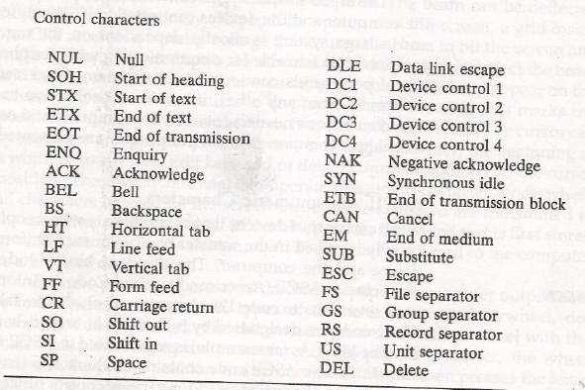

Slide 14
Input/Output Organization 14
I/O Interface
Provides a method for transferring information
Transfer between internal storage and external I/O devices
(such as memory and CPU registers)
Resolves the differences between the computer and peripheral devices
(1). Peripherals – Electromechanical or Electromagnetic Devices
CPU or Memory - Electronic Device
Conversion of signal values required

Slide 15
Input/Output Organization 15
I/O Interface
(2). Data Transfer Rate
Peripherals - Usually slower
CPU or Memory - Usually faster than peripherals
Some kinds of Synchronization mechanism may be needed
(3). Data formats or Unit of Information
Peripherals – Byte, Block, …
CPU or Memory – Word
(4). Operating modes of peripherals may differ
must be controlled so that not to disturbed other peripherals connected to CPU

Slide 16
Input/Output Organization 16
I/O Bus and Interface
I/O bus
Data
Processor
Address
Control
Interface
Interface
Interface
Interface
Keyboard
Magnetic
Magnetic
and
Printer
disk
tape
display
terminal

Slide 17
Input/Output Organization 17
I/O Bus and Interface
Interface :
- Decodes the device address (device code)
- Decodes the commands (operation)
- Provides signals for the peripheral controller
- Synchronizes the data flow and supervises
the transfer rate between peripheral and CPU or Memory
4 types of command interface can receive : control, status, data o/p and data i/p

Slide 18
Input/Output Organization 18
I/O Bus and Interface
Control command :
issued to activate peripheral and to inform what to do
Status command :
used to test various status condition in interface and peripherals
data o/p command :
causes the interface to respond by transferring data
From the bus into one of its registers
data i/p command :
interface receives an item of data from the peripheral
Then, places it in its buffer register.

Slide 19
Input/Output Organization 19
I/O Bus and Memory Bus
Functions of Buses
MEMORY BUS is for information transfers between CPU and the MM
I/O BUS is for information transfers.
Transfer between CPU and I/O devices through their I/O interface

Slide 20
Input/Output Organization 20
I/O Bus and Memory Bus
3 ways to bus can communicate with memory and I/O :
(1). use two separate buses,
one to communicate with memory , the other with I/O interfaces
- Computer has independent set of data, address and control bus
- one for accessing memory and another I/O.
- done in computers that have separate IOP other than CPU.
(2). Use one common bus for memory and I/O but separate control lines
for each
(3). Use one common bus for memory and I/O with common control
lines for both

Slide 21
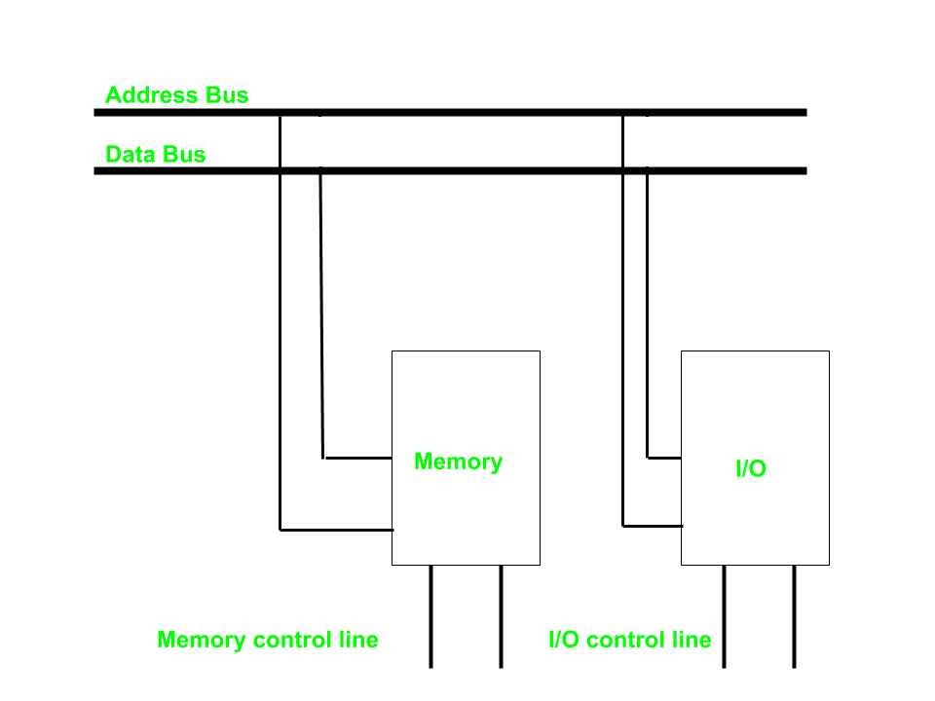
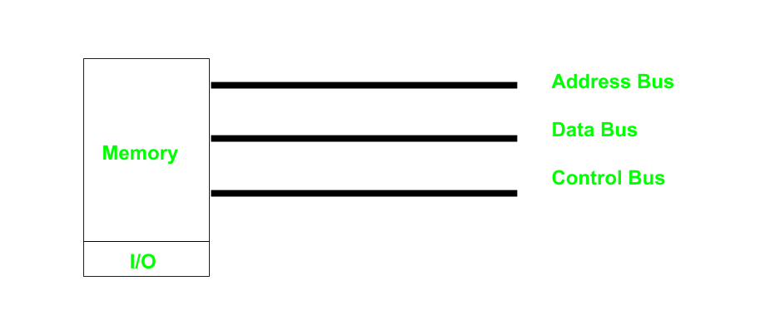

Slide 22
Input/Output Organization 22
Isolated vs. Memory Mapped I/O
Isolated I/O
- Many computers use common bus to transfer information between memory or I/O.
- The distinction between memory transfer and I/O transfer is made through separate read and write line.
-In the isolated I/O configuration ,
the CPU has distinct input and output instructions and each of these instruction is associated with the address of an interface register.
Distinct input and output instructions
each associated with address of interface register

Slide 23
Input/Output Organization 23
Isolated vs. Memory Mapped I/O
Memory-mapped I/O
- A single set of read/write control lines
(no distinction between memory and I/O transfer)
- Memory and I/O addresses share the common address space
-> reduces memory address range available
- No specific input or output instruction
-> The same memory reference instructions can
be used for I/O transfers
- Considerable flexibility in handling I/O operations

Slide 24
Input/Output Organization 24
I/O Interface
Port A
I/O data
Bidirectional
register
Bus
data bus
buffers
I/O data
Port B
register
CPU
Chip select
I/O
Device
Register select
CS
Internal bus
RS1
Control
Control
Register select
Timing
register
RS0
and
I/O read
Control
I/O write
RD
Status
Status
WR
register
CS RS1 RS0 Register selected
0 x x None - data bus in high-impedence
1 0 0 Port A register
1 0 1 Port B register
1 1 0 Control register
Programmable Interface
1 1 1 Status register
- Information in each port can be assigned a meaning depending on the mode of operation of the I/O device→ Port A = Data; Port B = Command;
- CPU initializes(loads) each port by transferring a byte to the Control Register
→ Allows CPU can define the mode of operation of each port
→ Programmable Port: By changing the bits in the control register, it is possible to change the interface characteristics

Slide 25
Input/Output Organization 25 Lecture 36
Peripheral Devices
Input-Output Interface
Asynchronous Data Transfer
Modes of Transfer
Priority Interrupt
Direct Memory Access
Input-Output Processor

Slide 26
Asynchronous Data Transfer
→Synchronous Data Transfer:
Uses a common clock for all registers.
Data transfer occurs simultaneously with clock pulses.
CPU and I/O Interface operate independently but share a clock for transfer.
→Asynchronous Data Transfer:
Each unit (CPU & Interface) has its own independent clock.
Control signals are required to synchronize data transfer
Each unit uses its own private clock for internal registers.
Asynchronous data transfer between two independent units requires that control signals

Slide 27
Asynchronous Data Transfer
Two methods:
STROBE: A control signal indicates when data is transmitted.
HANDSHAKING: A mutual agreement between units for data transfer

Slide 28
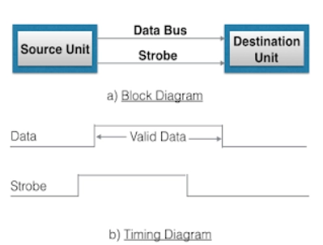
Source initiated strobe:
1
1
2
2

Slide 29
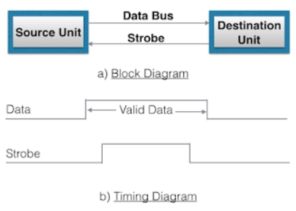
Destination initiated strobe:
2
2
1
1

Slide 30
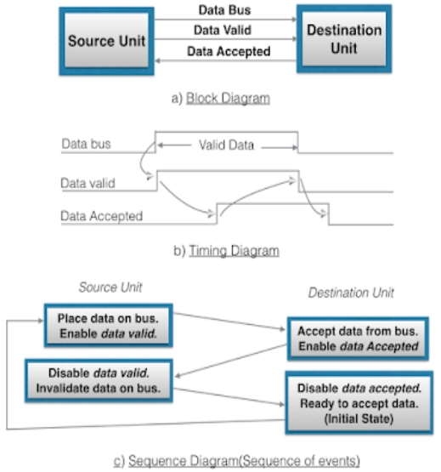
Source initiated handshaking:

Slide 31
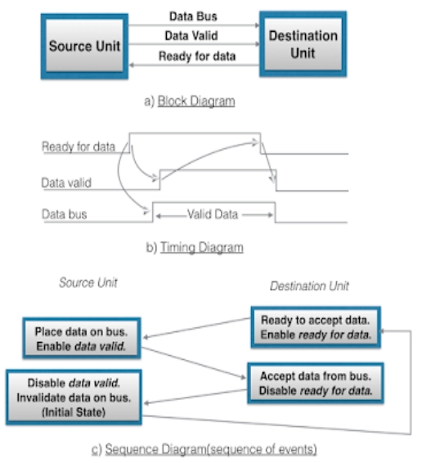
Timeout : If the return handshake signal does not respond within a given time period, the unit assumes that an error has occurred.

Slide 32
Asynchronous Serial Transfer
Synchronous transmission :
The two unit share a common clock frequency
Bits are transmitted continuously at the rate dictated by the clock pulses
Asynchronous transmission :
Binary information sent only when it is available and line remain idle otherwise
Special bits are inserted at both ends of the character code
Each character consists of three parts :
1) start bit : always “0”, indicate the beginning of a character
2) character bits : data
3) stop bit : always “1”

Slide 33
Asynchronous transmission rules :
① When a character is not being sent, the line is kept in the 1-state
② The initiation of a character transmission is detected from the start bit, which is always “0”
③ The character bits always follow the start bit
④ After the last bit of the character is transmitted, a stop bit is detected when the line returns to the 1-state for at least one bit time
Baud Rate : Data transfer rate in bits per second
10 character per second with 11 bit format = 110 bit per second

Slide 34
Input/Output Organization 34
Universal Asynchronous Receiver Transmitter
A typical asynchronous communication interface available as an IC
Transmit
Bidirectional
Transmitter
Shift
data
data bus
Bus
register
register
buffers
Control
Transmitter
Transmitter
register
control
clock
Chip select
and clock
CS
Internal Bus
RS
Timing
Status
Receiver
Receiver
CS RS Oper. Register selected
register
control
clock
0 x x None
I/O read
RD
and
and clock
1 0 WR Transmitter register
Control
Receive
1 1 WR Control register
I/O write
WR
Receiver
Shift
data
1 0 RD Receiver register
register
register
1 1 RD Status register
Transmitter Register
- Accepts a data byte(from CPU) through the data bus
- Transferred to a shift register for serial transmission
Receiver Register
- Receives serial information into another shift register
- Complete data byte is sent to the receiver register
Status Register Bits
- Used for I/O flags and for recording errors
Control Register Bits
- Define baud rate, no. of bits in each character, whether to generate and check parity, and no. of stop bits

Slide 35
UART stands for?
a. Universal Asynchronous Sender Receiver
b. Universal Asynchronous Receiver Transmitter
c. Universal Synchronous Receiver Transmitter
d. None Of These.

Slide 36
Overview
Peripheral Devices
Input-Output Interface
Asynchronous Data Transfer
Modes of Transfer
Priority Interrupt
Direct Memory Access
Input-Output Processor

Slide 37
Modes of Transfer
Binary information received from external device is usually stored in memory.
Information transferred from central computer into an external device originates in the memory unit.
The CPU merely execute I/O instructions and may accept data temporarily but ultimate source or destination is the Memory Unit.

Slide 38
Modes of Transfer
Data transfer between central computer and I/O devices may be handled in a variety of modes.
Some modes use CPU as intermediate path,
others transfer data directly to and from memory unit.
Data Transfer to or from peripheral can be handled in one of three possible modes :
Programmed I/O
Interrupt-Initiated I/O
Direct Memory Access (DMA)

Slide 39
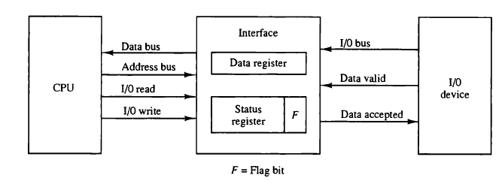
Input/output Organization 39
Modes of Transfer – Programmed I/O

Slide 40
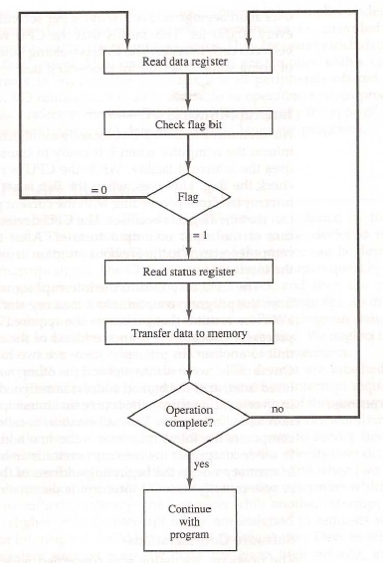

Slide 41
Programmed I/O
- Programmed I/O operations are the result of I/O Instructions written in computer program.
- Each data item transfer is initiated by an instruction in the program.
Usually, transfer is to and from a CPU register to peripheral.
Other instructions are needed to transfer data to and from CPU and Memory
Transferring data under program control requires constant monitoring of the peripheral by CPU.

Slide 42
In programmed I/O method,
CPU stays in a program loop until the I/O unit indicated that it is ready for data transfer.
This is a time consuming process since it keeps the processor busy needlessly.
It can be avoided by using Interrupt facility and special commands
Interrupt to inform the interface to issue an interrupt request signal when data are available for the device.

Slide 43
Interrupted I/O
In the programmed I/O method, the CPU stays in a program loop until the I/O unit indicates that it is ready for data transfer.
This is a time-consuming process since it keeps the processor busy needlessly.
It can be avoided by using an interrupt facility and special commands to inform the interface to issue an interrupt request signal when the data are available from the device.
In the meantime the CPU can proceed to execute another program. The interface meanwhile keeps monitoring the device.

Slide 44
Interrupted I/O
When the interface determines that the device is ready for data transfer, it generates an interrupt request to the computer.
Upon detecting the external interrupt signal, the CPU momentarily stops the task it is processing,
Then, Branches to a service program to process the I/O transfer, and then returns to the task it was originally performing.

Slide 45
DMA
Programmed I/O: In this method, data moves between the CPU and external devices (like a keyboard, printer, or hard drive). The CPU controls the entire process.
Direct Memory Access (DMA): Instead of the CPU handling data transfer, a special hardware unit (DMA controller) transfers data directly between memory and external devices.
CPU’s Role in DMA: The CPU starts the transfer by giving the DMA controller a memory address and the amount of data to transfer. Then, the CPU moves on to other tasks.
How DMA Works: When the DMA is ready to transfer data, it requests permission to use the memory bus (the pathway between memory and other parts of the system).
Notes:
DMA is more efficient for large data transfers since it frees the CPU and speeds up the process.
Interrupt-Initiated I/O is simpler but can slow down the CPU, making it less suitable for handling large amounts of data.

Slide 46
DMA
Memory Controller’s Role: Once the memory controller allows access, the DMA controller moves data directly between the external device and memory.
Effect on CPU: The CPU temporarily pauses its memory operations while DMA transfers data but resumes immediately after.
Why This Matters: Since most external devices (like hard drives) work much slower than the CPU, these data transfers happen less frequently compared to how often the CPU accesses memory.
This approach allows the CPU to work on other tasks while data transfer happens in the background, improving overall system efficiency.
Notes:
DMA is more efficient for large data transfers since it frees the CPU and speeds up the process.
Interrupt-Initiated I/O is simpler but can slow down the CPU, making it less suitable for handling large amounts of data.

Slide 47
Priority Interrupts
Priority
- Determines which interrupt is to be served first,
when two or more requests are made simultaneously
- Also determines which interrupts are permitted to interrupt the computer,
while another is being serviced
- Higher priority interrupts can make requests while servicing a lower priority
interrupt

Slide 48
Priority Interrupts
A priority interrupt is a system that establishes priority over the various sources to determine
- which condition is to serviced first when two or more requests
arrive simultaneously
-which conditions are permitted to interrupt the computer while
another request is being serviced

Slide 49
Priority Interrupts
Priority Interrupt by Software (Polling)
Polling procedure is used to identify highest priority source by software
means
- common branch address for all the interrupts
- Priority is established by the order of polling the devices(interrupt sources)
- highest priority device is tested first and if interrupt is on ,
- control branches to service routine for this source otherwise next lower priority source is tested

Slide 52
Priority Interrupts
- Flexible since it is established by software
- Low cost since it needs a very little hardware
- Very slow
- if there are many interrupt time required to poll may exceed time available to
service IO device

Slide 53
Priority Interrupts
Priority Interrupt by Hardware
- Require a priority interrupt manager which accepts all the interrupt requests
to determine the highest priority request
- Fast since identification of the highest priority interrupt request is identified by
the hardware
- Fast since each interrupt source has its own interrupt vector to access
directly to its own service routine
- Can be addressed using serial or parallel connection of interrupt lines.
Example of serial is Daisy chaining Priority

Slide 54
Hardware Priority Interrupts – Daisy Chain
VAD 1
VAD 2
VAD 3
* Serial hardware priority function
* Interrupt Request Line
- Single common line
* Interrupt Acknowledge Line
- Daisy-Chain
Device 1
Device 2
Device 3
PI
PO
PI
PO
PI
PO
To next
device
Interrupt request
INT
CPU
Interrupt acknowledge
INTACK
Serial connection of all device that request an interrupt
Device with highest priority placed in first position followed by devices with lower priority and so on.
Interrupt generated by any device → signals low state interrupt line
CPU responds by enabling interrupt acknowledgement (INTACK) line.
device receives PI=1 and passes to next only when not requesting else PI=0
Thus device with PI=1 and PO=0 is one with highest priority requesting interrupt

Slide 56
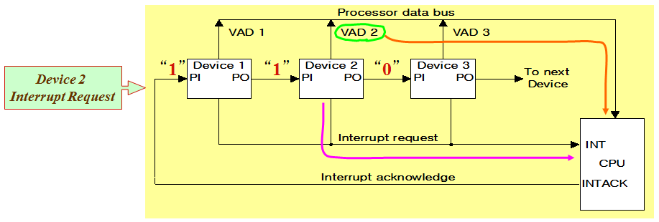
Hardware Priority Interrupts – Daisy Chain
Example: Daisy chain working

Slide 57
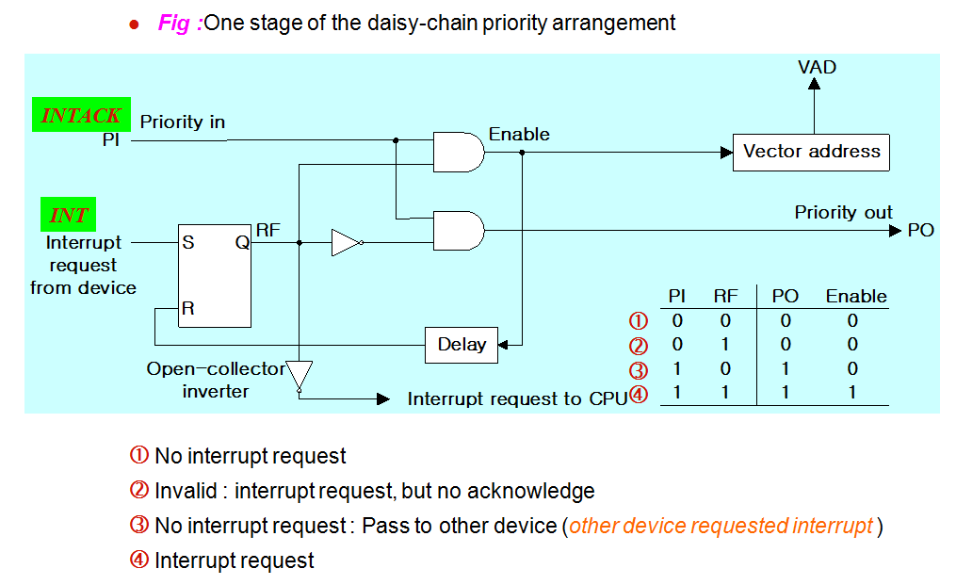
Hardware Priority Interrupts – Daisy Chain

Slide 58
Parallel Priority Interrupts
Interrupt register
Bus
Buffer
Disk
0
I
0
y
Printer
1
I
x
1
Priority
0
Reader
2
I
encoder
2
0
VAD
Keyboard
3
I
0
to CPU
3
0
0
IEN
IST
0
Mask
0
register
1
Enable
2
Interrupt
3
to CPU
INTACK
from CPU
IEN: Set or Clear by instructions ION or IOF
IST: Represents an unmasked interrupt has occurred. INTACK enables tristate Bus Buffer to load VAD generated by the Priority Logic
Interrupt Register:
- Each bit is associated with an Interrupt Request from different Interrupt Source - different priority level
- Each bit can be cleared by a program instruction
Mask Register:
- Mask Register is associated with Interrupt Register
- Each bit can be set or cleared by an Instruction

Slide 59
Priority Encoder
Determines the highest priority interrupt when more than one interrupts take place
Priority Encoder Truth table
Inputs
Outputs
I₀
I₁
I₂
I₃
x y IST
Boolean functions
1 d d d
0 0 1
0 1 d d
0 1 1
0 0 1 d
1 0 1
x = I₀' I₁'
0 0 0 1
1 1 1
y = I₀' I₁ + I₀’ I₂’
0 0 0 0
d d 0
(IST) = I₀ + I₁ + I₂ + I₃

Slide 60
Interrupt Cycle
At the end of each Instruction cycle
- CPU checks IEN and IST
- If IEN • IST = 1, CPU -> Interrupt Cycle
SP ← SP - 1 Decrement stack pointer
M[SP] ←  PC Push PC into stack
INTACK ←  1 Enable interrupt acknowledge
PC ←  VAD Transfer vector address to PC
IEN ←  0 Disable further interrupts
Go To Fetch to execute the first instruction
in the interrupt service routine

Slide 61
Initial and Final Operations
0
JMP DISK
DISK
7
Program to service
1
JMP PTR
magnetic disk
VAD=00000011
3
2
JMP RDR
PTR
Program to service
3
JMP KBD
8
line printer
KBD
interrupt
1
Main program
RDR
749
current instr.
Program to service
750
character reader
KBD
4
Stack
Program to service
11
5
keyboard
2
256
Disk
interrupt
255
256
750
Initial and Final Operations
6
9
10
Each interrupt service routine must have an initial and final set of
operations for controlling the registers in the hardware interrupt system
Initial Sequence
[1] Clear lower level Mask reg. bits
[2] IST <- 0
[3] Save contents of CPU registers
[4] IEN <- 1
[5] Go to Interrupt Service Routine
Final Sequence
[1] IEN <- 0
[2] Restore CPU registers
[3] Clear the bit in the Interrupt Reg
[4] Set lower level Mask reg. bits
[5] Restore return address, IEN <- 1

Slide 62
In Daisy Chaining Priority if the device does not have any pending interrupt requests then the value of PI and PO will be
a. PI=0, PO=0
b. PI=0, PO=1
c. PI=1, PO=0
d. PI=1, PO=1

Slide 63
Input/Output Organization 63
Overview
Peripheral Devices
Input-Output Interface
Asynchronous Data Transfer
Modes of Transfer
Priority Interrupt
Direct Memory Access
Input-Output Processor

Slide 64
Input/Output Organization 64
Direct Memory Access
Block of data transfer between high speed devices like Disk and Memory
* DMA controller - Interface which takes over the buses to manage the transfer directly between
Memory and I/O Device, freeing CPU for other tasks
* CPU initializes DMA Controller by sending memory address and the block size (number of words)

Slide 65
Input/Output Organization 65
Direct Memory Access
Fig 1: CPU bus signals for DMA transfer (Bus control by DMA)
ABUS
Address bus
Bus request
BR
DBUS
Data bus
Bus granted
BG
CPU
RD
Read
WR
Write
Fig 2: Block diagram of DMA controller
Data bus
Data bus
Address bus
Address register:
Contains an address to specify
Desired location in memory
Word count register
Holds no. of words to be transferred
Control register
Specifies the mode of transfer
buffers
buffers
DMA select
DS
Address register
RS
Internal Bus
Read
RD
Word count register
Write
WR
Control
logic
Control register
Bus request
BR
Bus grant
BG
Interrupt
Interrupt
DMA request
DMA acknowledge
to I/O device

Slide 66
Input/Output Organization 66
Direct Memory Access
RD and WR is bidirectional
When BG=0 CPU can communicate with DMA Register (RW info.)
When BG=1 CPU left the buses and DMA can communicate directly with memory
DMA Transfer can be made in several ways
Burst Transfer :
a block sequence consisting of memory words is transferred in continuous burst while the DMA controller is master of memory bus
This mode of transfer is needed for fast devices such as magnetic disk where data transmission cannot be stopped or slowed down until an entire block is transferred

Slide 67
Input/Output Organization 67
Direct Memory Access
(2) Cycle stealing :
Alternative technique called cycle stealing allows DMA controller to transfer one data word at time after which it must return control of the buses to the CPU.
CPU merely delays its operation for one memory cycle to allow the direct memory I/O transfer to “steal” one memory cycle

Slide 68
Input/Output Organization 68
DMA I/O Operation
DMA is first initialized by CPU. After that DMA starts and continues to transfer data between memory and peripheral unit until an entire block is transferred.
CPU initializes the DMA by sending following information through data bus:
(1) Starting address of the memory block (for read/write)
(2) Word Count (no. of words in memory block)
(3) Control to specify mode of transfer (E.g. read/write)
(4) A control to start DMA Transfer

Slide 69
Input/Output Organization 69
Cycle Stealing
While DMA I/O takes place, CPU is also executing instructions
DMA Controller and CPU both access Memory -> Memory Access Conflict
Memory Bus Controller
- Coordinating the activities of all devices requesting memory access
- Priority System
Memory accesses by CPU and DMA Controller are interwoven,
with the top priority given to DMA Controller

Slide 70
Input/Output Organization 70
Cycle Stealing
Cycle Steal
- CPU is usually much faster than I/O(DMA), thus CPU uses the most of the memory cycles
- DMA Controller steals the memory cycles from CPU
- For those stolen cycles, CPU remains idle
- For those slow CPU, DMA Controller may steal most of the memory
cycles which may cause CPU remain idle long time

Slide 71
Input/Output Organization 71
DMA Transfer
Interrupt
BG
Random-access
CPU
memory unit (RAM)
BR
RD
WR
Addr
Data
RD
WR
Addr
Data
Read control
Write control
Data bus
Address bus
Address
select
RD
WR
Addr
Data
DS
DMA ack.
RS
DMA
I/O
BR
Controller
Peripheral
device
BG
DMA request
Interrupt

Slide 72
Input/Output Organization 72
I/O Processor - Channel
Channel
- Processor with direct memory access capability that communicates with I/O devices
- Channel accesses memory by cycle stealing
- Unlike DMA Controller, IOP can fetch and execute its own instruction
- IOP Instructions (Commands) specially designed to facilitate I/O transfer.
Central
processing
unit (CPU)
Peripheral devices
Memory
Memory Bus
unit
PD
PD
PD
PD
Input-output
processor
I/O bus
(IOP)

Slide 73
Input/Output Organization 73
I/O Processor - Channel
- Data gathered in IOP at device rate and bit capacity while CPU executing own program
- Transfer between IOP and Device similar to Programmed I/O and
transfer between IOP and Memory similar to DMA
- CPU is master while IOP is slave processor
- CPU initiates the channel by executing a channel I/O class instruction and once initiated, channel operates independent of the CPU
Central
processing
unit (CPU)
Peripheral devices
Memory
Memory Bus
unit
PD
PD
PD
PD
Input-output
processor
I/O bus
(IOP)

Slide 74
Input/Output Organization 74
Channel CPU Communication
CPU operations
IOP operations
Send instruction
to test IOP.path
Transfer status word
to memory
If status OK, then send
start I/O instruction
to IOP.
Access memory
for IOP program
CPU continues with
another program
Conduct I/O transfers
using DMA;
Prepare status report.
I/O transfer completed;
Interrupt CPU
Request IOP status
Transfer status word
Check status word
to memory location
for correct transfer.
Continue

